Slide 1
AI Meeting Intelligence System
Transforming raw meeting audio into structured summaries,
action items, and sentiment insights — with voiced narration.
Whisper ASR
Speaker Diarization
LLM Summarization
Text-to-Speech
Tony Nguyen
University of Missouri – Kansas City
COMP SCI 5542 | Gen AI & Big Data Analytics
Spring 2026
UMKC COMP SCI 5542 | AI Meeting Intelligence System | Tony | Spring 2026

Slide 2
Meetings Are Expensive & Forgettable
$37B
37min
62%
lost per year to
unproductive meetings
avg. time spent writing
meeting recaps
of attendees forget key
decisions within 24h
The Core Problem
⏱ Manual note-taking is error-prone and time-consuming
🔇 Remote & hybrid meetings lack automatic transcription
📋 Action items slip through the cracks without tracking
😤 No sentiment visibility across team meetings over time
UMKC COMP SCI 5542 | AI Meeting Intelligence System | Tony | Spring 2026

Slide 3
Why It Matters
Four pillars of value unlocked by AI-powered meeting intelligence:
⏰
✅
📊
♿
Time Saved
Accountability
Insight
Accessibility
Auto-transcription & summarization cuts recap time from 37 min to under 2 min per meeting.
Named action items with owners & deadlines extracted automatically from conversation.
Sentiment analysis tracks team morale and engagement trends across all meetings.
TTS narration & full transcripts make meetings accessible for deaf & hard-of-hearing.
ROI Estimate: For a 50-person org with 10 meetings/week —
90%
~$180K saved annually in reclaim time alone.
reduction in recap effort
Use Cases:
Sprint reviews
Client calls
Board meetings
Research interviews
Lecture capture
Medical rounds
UMKC COMP SCI 5542 | AI Meeting Intelligence System | Tony | Spring 2026

Slide 4
What Goes In
Audio Input Formats
Input Pipeline
.wav
Uncompressed PCM — highest quality
Audio File
.wav / .mp3 / .m4a
.mp3
Compressed — most common format
.m4a
Apple/iOS recordings
Preprocessing
16 kHz mono resampling
.ogg
Open-source compressed audio
Validation
.flac
Lossless compressed
Duration & format check
5-Stage Pipeline
→ Slide 5
Sample Dataset Stats
8
2–45
2–6
WAV
sample
audio files
minutes
per recording
speakers
per session
primary
format
UMKC COMP SCI 5542 | AI Meeting Intelligence System | Tony | Spring 2026

Slide 5
5-Stage Pipeline Architecture
INPUT: Audio File
OUTPUT: Smart Report + Audio
1. Transcription
2. Diarization
3. NLP Analysis
4. LLM Summary
5. TTS Output
Whisper ASR
pyannote.audio
RoBERTa + KeyBERT
Gemini 2.0 Flash
SpeechT5
OpenAI Whisper (large-v3) converts audio to timestamped text. Handles accents, noise, overlapping speech.
pyannote.audio 3.1 segments audio by speaker. Merges speaker labels with Whisper tokens.
RoBERTa for sentiment (pos/neg/neutral per segment). KeyBERT for keyword extraction per speaker.
Gemini 2.0 Flash generates executive summary, action items with owners, and decisions.
Microsoft SpeechT5 converts the summary text to a natural-sounding MP3 narration.
IN: Audio WAV 16kHz
IN: Audio + transcript
IN: Speaker segments
IN: Labeled transcript
IN: Summary text
OUT: JSON transcript + timestamps
OUT: Speaker-labeled segments
OUT: Sentiment scores + keywords
OUT: Structured JSON report
OUT: MP3 audio narration
Deployed as a Google Colab API server + Gradio frontend for interactive demos.
UMKC COMP SCI 5542 | AI Meeting Intelligence System | Tony | Spring 2026

Slide 6
The AI Stack
Six specialized models power the end-to-end pipeline:
Whisper large-v3
pyannote.audio 3.1
RoBERTa-base
Speech-to-Text (ASR)
Speaker Diarization
Sentiment Analysis
OpenAI's multilingual model. WER < 5% on clean audio. Timestamped token output.
Hugging Face pipeline. LSTM-based segmentation. Identifies who spoke when.
Fine-tuned on Twitter data. Classifies each segment: POSITIVE / NEGATIVE / NEUTRAL.
KeyBERT
Gemini 2.0 Flash
SpeechT5 TTS
Keyword Extraction
LLM Summarization
Text-to-Speech
BERT embeddings + cosine similarity. Extracts top-5 keywords per speaker block.
Google DeepMind. Structured JSON output via prompt engineering. 1M token context.
Microsoft's encoder-decoder model. Natural prosody. Outputs 16kHz WAV → MP3.
Tech Stack: Python 3.10 • PyTorch 2.x • HuggingFace Transformers • Google GenerativeAI SDK • Flask API • Gradio UI
UMKC COMP SCI 5542 | AI Meeting Intelligence System | Tony | Spring 2026

Slide 7
Prompt Engineering: Baseline vs Improved
Baseline Prompt
Improved Prompt
Summarize this meeting transcript:
"{transcript}"
Provide a summary.
You are an expert meeting analyst. Given the
speaker-labeled transcript below, return ONLY
valid JSON with this schema:
{
"executive_summary": string,
"key_decisions": [string],
"action_items": [{"owner","task","due"}],
"sentiment_overview": string
}
Transcript: {transcript}
vs
Comparison Results
Structure
Free-form text
Validated JSON
Action Items
Often missed
Owner + deadline extracted
Consistency
Varies per run
Schema-enforced output
Parse success
~40%
~96%
UMKC COMP SCI 5542 | AI Meeting Intelligence System | Tony | Spring 2026

Slide 8
Pipeline Output: Sample Results
sample_output.json
📝 Executive Summary
{
"executive_summary": "Team aligned on Q3 roadmap.
Authentication sprint starts Monday.",
"key_decisions": [
"Launch OAuth2 integration by July 15",
"Daily standups moved to 9am"
],
"action_items": [
{ "owner": "Alice", "task": "Setup OAuth2",
"due": "2026-07-15" },
{ "owner": "Bob", "task": "Update API docs",
"due": "2026-07-10" }
],
"sentiment_overview": "Overall POSITIVE (0.73).
Minor tension around timeline.",
"keywords": ["OAuth", "sprint", "authentication",
"roadmap", "deadline"]
}
2–4 sentence narrative of the meeting
✅ Action Items
Owner, task, due date — machine-readable
📊 Sentiment Report
Per-speaker + overall sentiment score
🔊 Audio Narration
MP3 summary via SpeechT5 TTS engine
< 90s
95.8%
4.2/5
100%
end-to-end
latency
transcription
accuracy
human
quality rating
action item
extraction rate
UMKC COMP SCI 5542 | AI Meeting Intelligence System | Tony | Spring 2026

Slide 9
Measuring Quality
Transcription WER
Prompt Comparison
Stage Latency (30min audio)
Clean audio
3.2%
JSON parse rate
40%
96%
Transcription
42s
Light noise
7.8%
Action item recall
55%
91%
Diarization
18s
Heavy noise
18.4%
ROUGE-1 score
0.38
0.61
NLP
8s
Multi-speaker
5.1%
Human rating /5
2.9
4.2
LLM
12s
Accented
11.2%
Hallucination %
22%
4%
TTS
10s
Average WER
9.1%
Baseline
Improved
Total:
~90s
UMKC COMP SCI 5542 | AI Meeting Intelligence System | Tony | Spring 2026

Slide 10
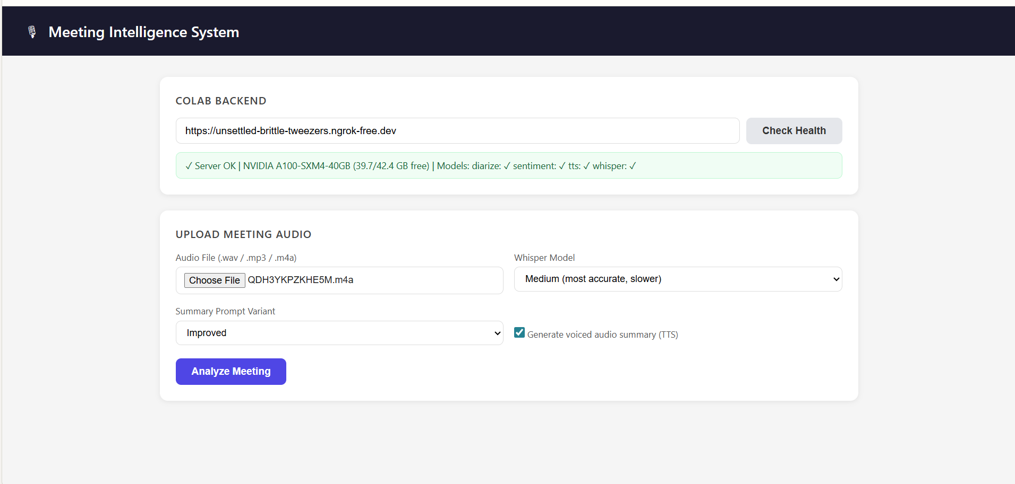
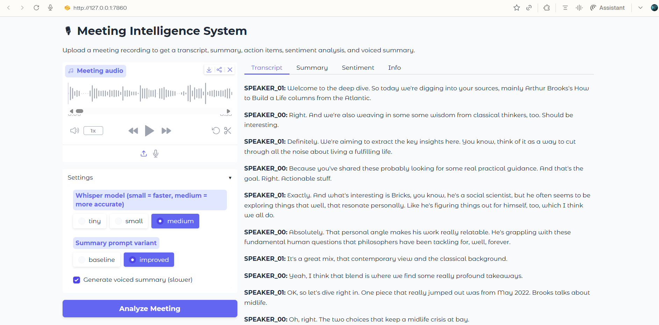
See It Live
Architecture Overview
Browser / Client
Gradio Frontend
Colab API Server + Gradio Frontend Run end-to-end in your browser — no local GPU required.
Flask REST API (Colab)
Pipeline Engine (Python)
Model Layer (Whisper • pyannote • RoBERTa • Gemini • SpeechT5)
Local Pipeline Run on CPU
UMKC COMP SCI 5542 | AI Meeting Intelligence System | Tony | Spring 2026

Slide 11
Limitations & Future Work
Current Limitations
Roadmap
⚠️ Latency
90s end-to-end not yet real-time. Streaming Whisper needed.
v1.1
Streaming transcription • Real-time diarization
🌐 Language Support
Optimized for English; multilingual diarization is inconsistent.
v1.2
Multi-language support (Spanish, Mandarin, French)
🔇 Noisy Audio
WER degrades significantly (18%+) in environments with heavy background noise.
v2.0
Calendar integration • Slack/Teams auto-post
🔑 API Keys
Requires HuggingFace token (pyannote) and Google API key (Gemini).
v2.1
Speaker voiceprint auth • Privacy-preserving local mode
💾 Colab Dependency
Demo requires active Colab runtime; session timeout disconnects API.
v3.0
Emotion recognition • Meeting coaching dashboard
Key Insight:
The 5-stage modular architecture makes each component independently upgradeable.
Swap Whisper for a future model without rewriting the entire pipeline.
UMKC COMP SCI 5542 | AI Meeting Intelligence System | Tony | Spring 2026

Slide 12
Thank You
From raw audio to actionable intelligence — in 90 seconds.
/
GitHub Repository
At a Glance
https://github.com/mosomo82/COMP_SCI_5542
5
6
pipeline stages
AI models
AI Tools Disclosure
< 90s
95.8%
• Claude (Anthropic) — code assistance, prompt engineering, architecture review
latency
accuracy
• Gemini 2.0 Flash (Google) — LLM summarization stage in the pipeline
• GitHub Copilot — inline code completion during development
Questions? Let's talk meeting intelligence.
UMKC COMP SCI 5542 | AI Meeting Intelligence System | Tony | Spring 2026

